Slide 1
Cisco Intercloud Fabric
Amazon AWS & Microsoft Azure – Cloud Access Keys
John McDonough (jomcdono@cisco.com)
Technical Marketing Engineer
January, 2015

Slide 2
Cloud Access Keys
Amazon – AWS
Microsoft – Azure

Slide 3
Amazon – AWS

Slide 4
Amazon – AWS Account and Keys Steps
Sign up for AWS account - http://aws.amazon.com
Create Amazon login Credentials
Sign up for AWS
Fill in Contact Information
Fill in Payment Information
Identity Verification
Select Support Plan, this will complete the process and you will need to sign in again
Launch Management Console, using the credentials just created
Click on your Account Name and Click the “Security Credentials” option in the drop-down
Click on “Users” in the left hand navigation, then Click “Create New Users” button
Enter A User Name, up to five can be entered, then Click the “Create” button
Notes:
Add a line that we are using VSG and CSR

Slide 5
Amazon – AWS Account and Keys Steps continued
Click “Show User Security Credentials”, this is the only time the credentials are available. New credentials can be generated at any time, however processes that use these credentials will have to be updated. These credentials are needed for the ICFB “IcfCloud” setup process.
Click “Download Credentials” button, a “credentials.csv.txt” file will be downloaded, then Click “close”
Click on the user name
Scroll down and click the “Attach User Policy” button
Scroll to the “Amazon EC2 Full Access” Policy and click the “Select” button
Click “Apply Policy” button
Apply the Policy for “Amazon S3 Full Access” the same way the EC2 policy was attached to the user
Use the created credentials in the IcfCloud setup for ICFB
Notes:
Add a line that we are using VSG and CSR

Slide 6
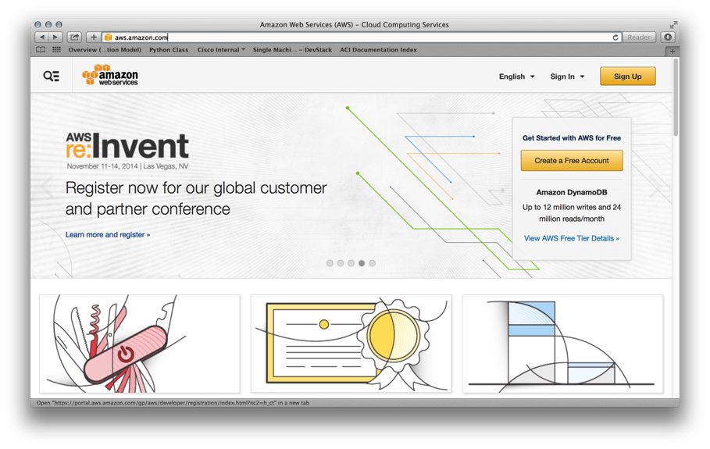
Sign up for AWS account - http://aws.amazon.com

Slide 7
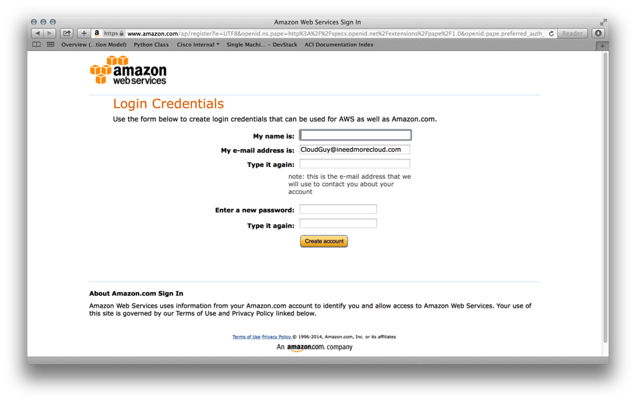
Create Amazon login Credentials

Slide 8
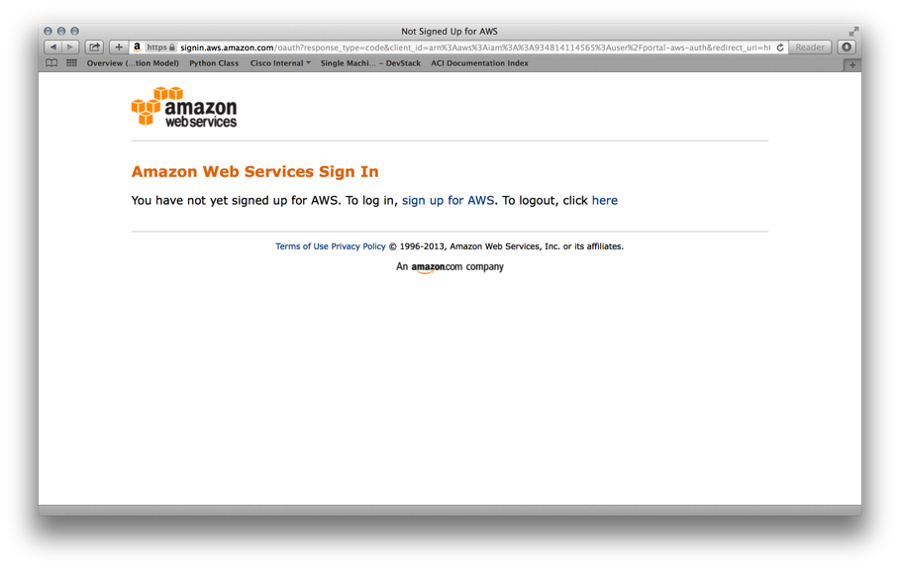
Sign up for AWS

Slide 9
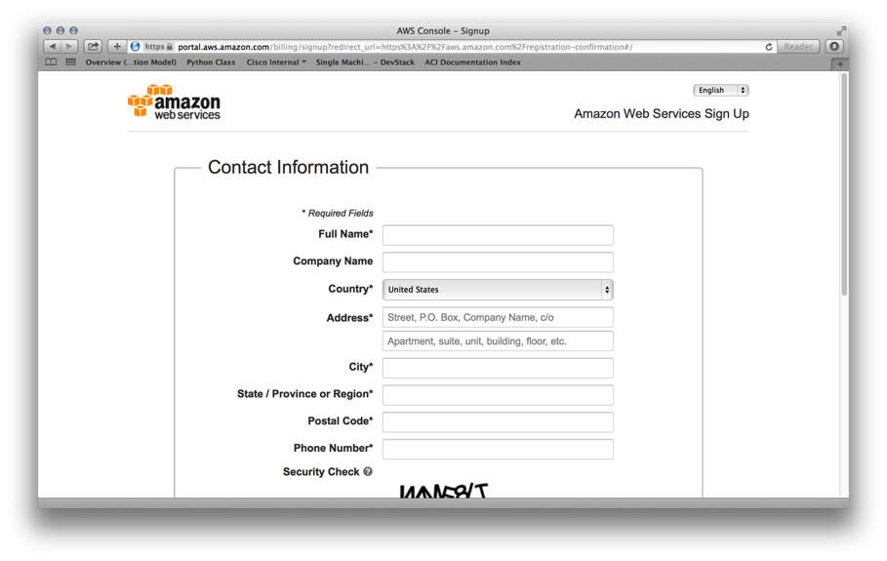
Fill in Contact Information

Slide 10
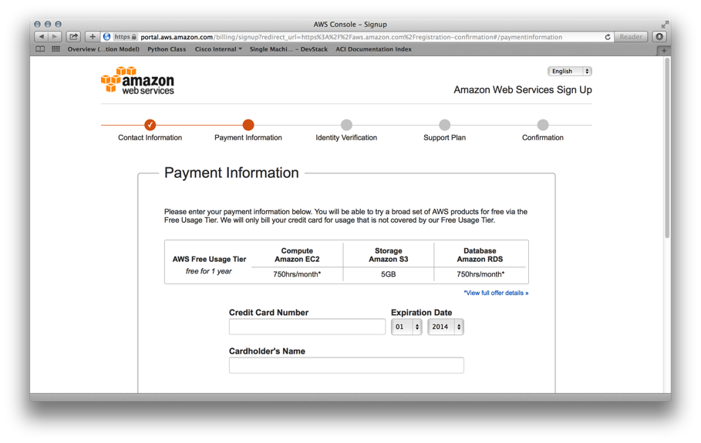
Fill in Payment Information

Slide 11
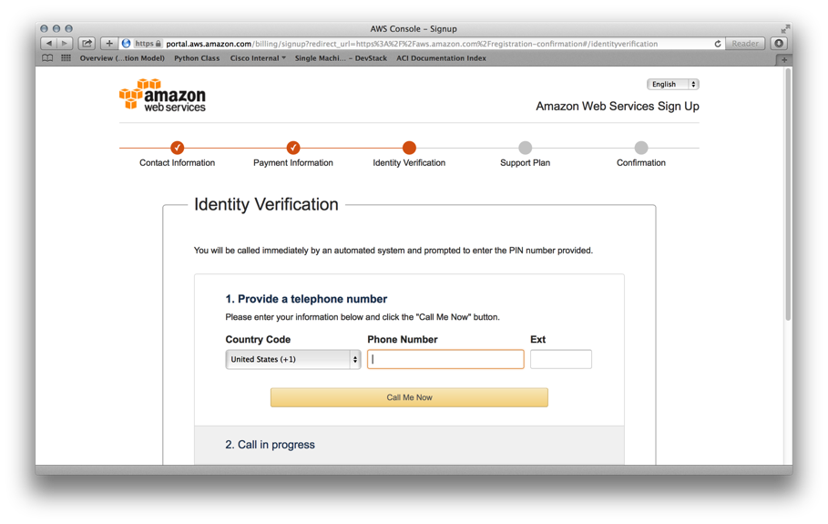
Identity Verification

Slide 12
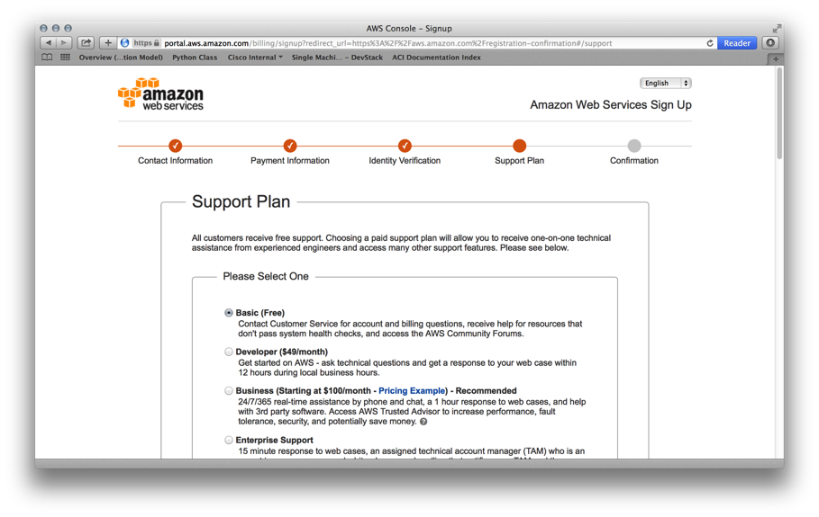
Select Support Plan, this will complete the process and you will need to sign in again

Slide 13
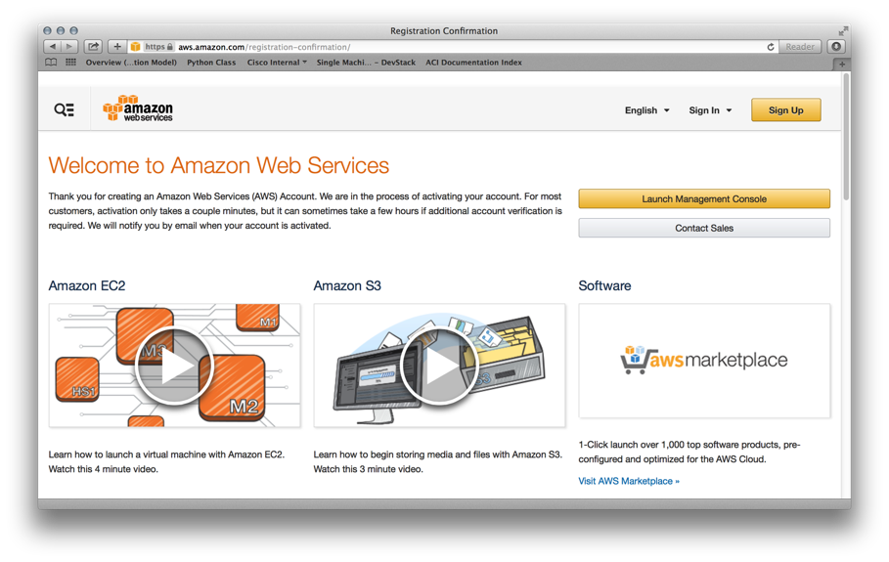
Launch Management Console, using the credentials just created

Slide 14
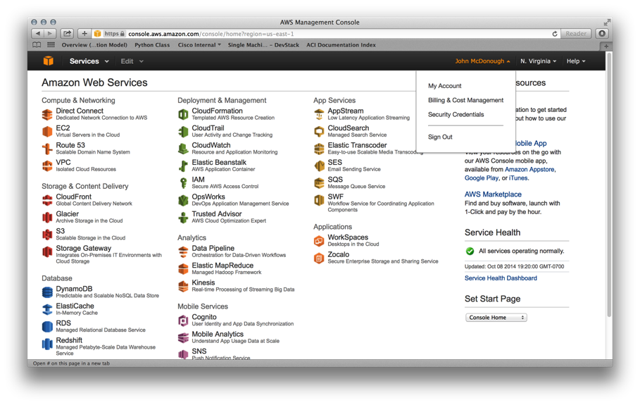
Click on your Account Name and Click the “Security Credentials” option in the drop-down

Slide 15
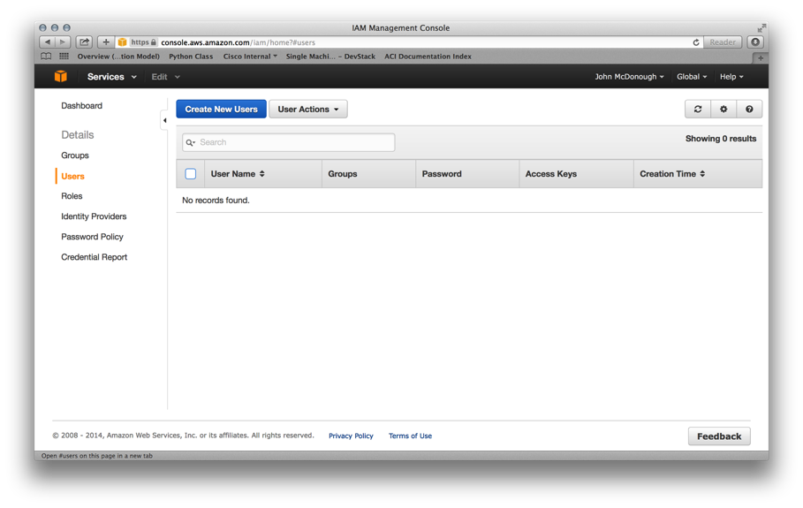
Click on “Users” in the left hand navigation, then Click “Create New Users” button

Slide 16
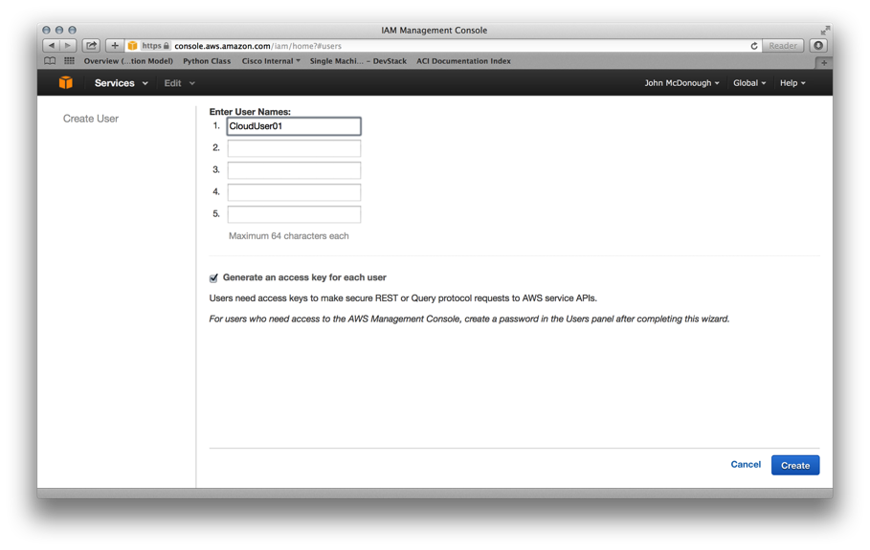
Enter A User Name, up to five can be entered, then Click the “Create” button

Slide 17
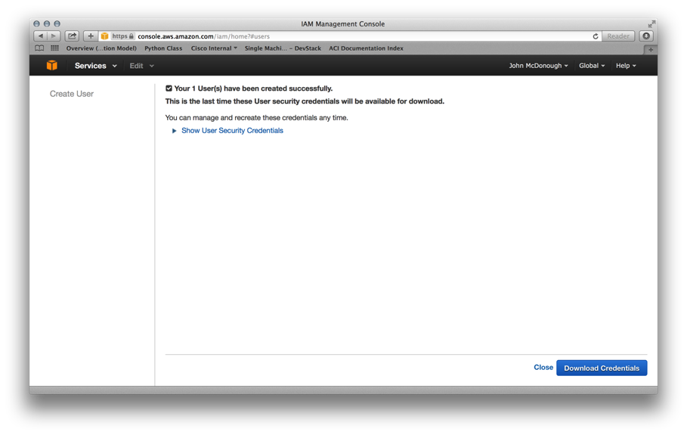
Click “Show User Security Credentials”, this is the only time the credentials are available. New credentials can be generated at any time, however processes that use these credentials will have to be updated. These credentials are needed for the ICFB “IcfCloud” setup process.

Slide 18
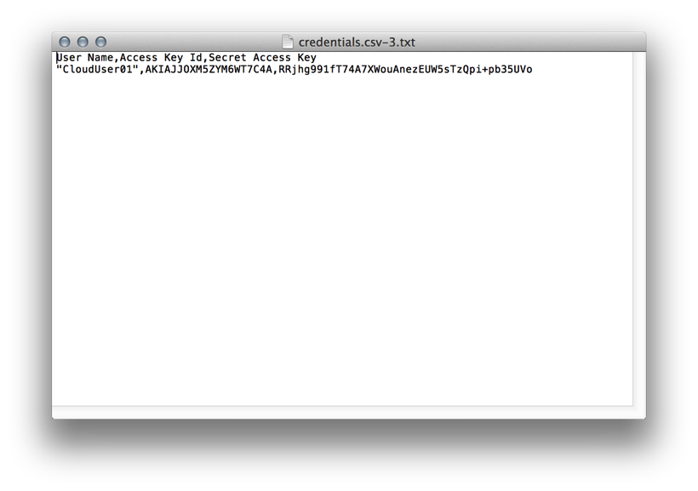
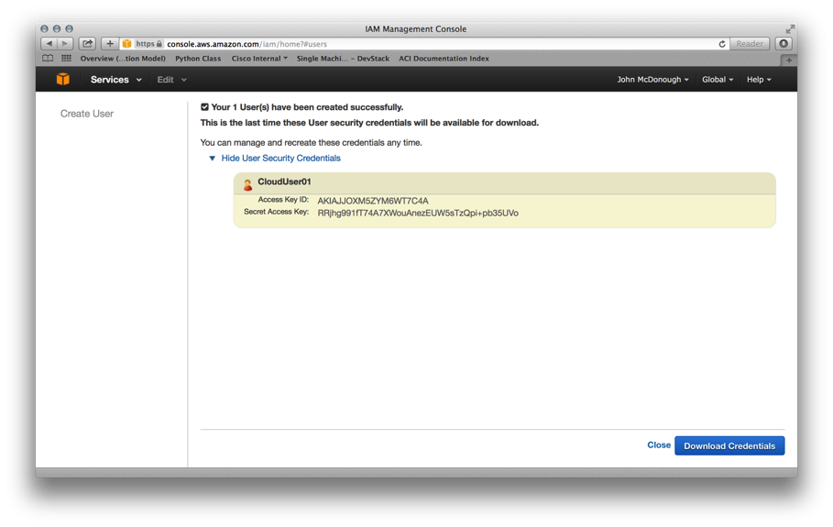
Click “Download Credentials” button, a “credentials.csv.txt” file will be downloaded, credentials in the picture are not active, then Click “close”

Slide 19
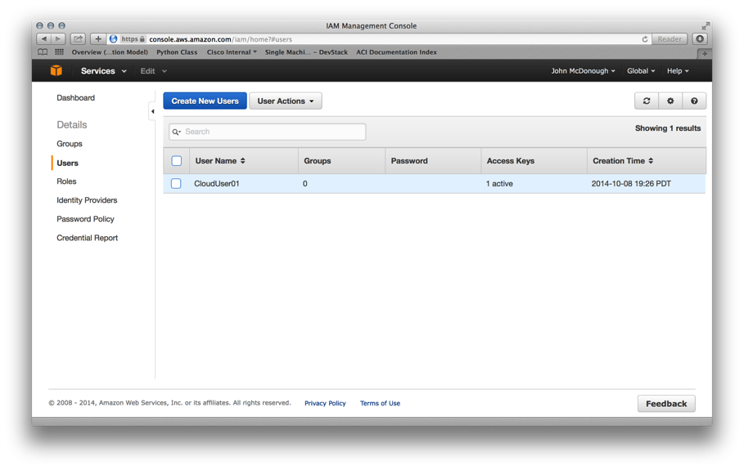
Click on the user name

Slide 20
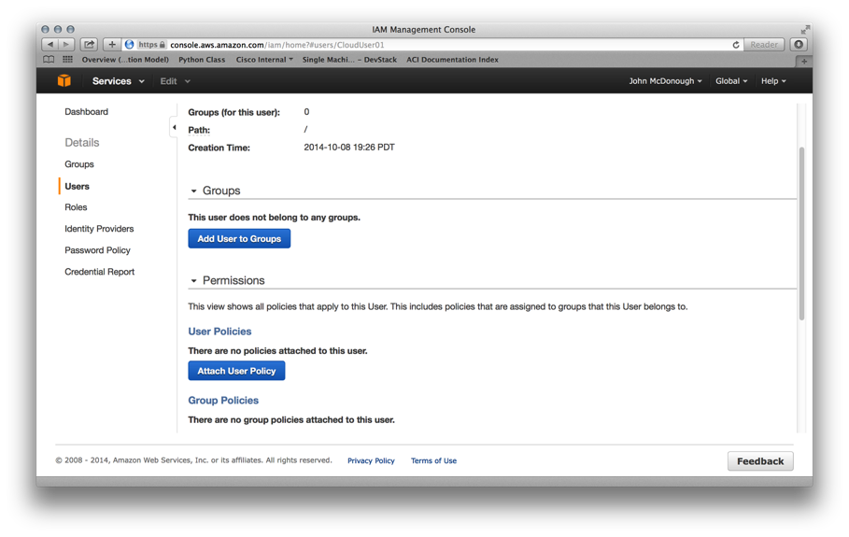
Scroll down and click the “Attach User Policy” button

Slide 21
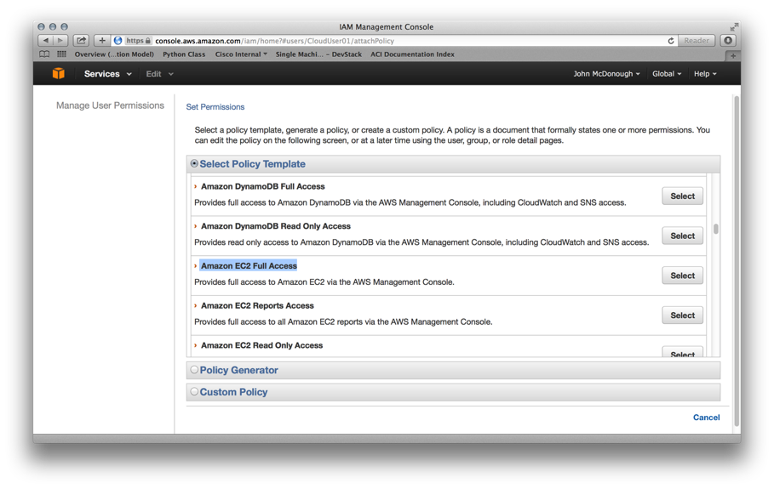
Scroll to the “Amazon EC2 Full Access” Policy and click the “Select” button

Slide 22
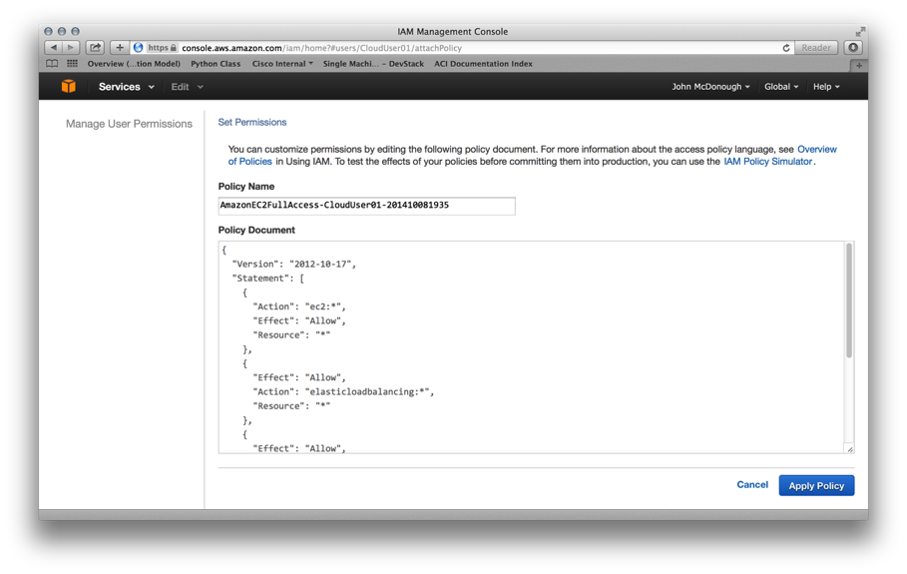
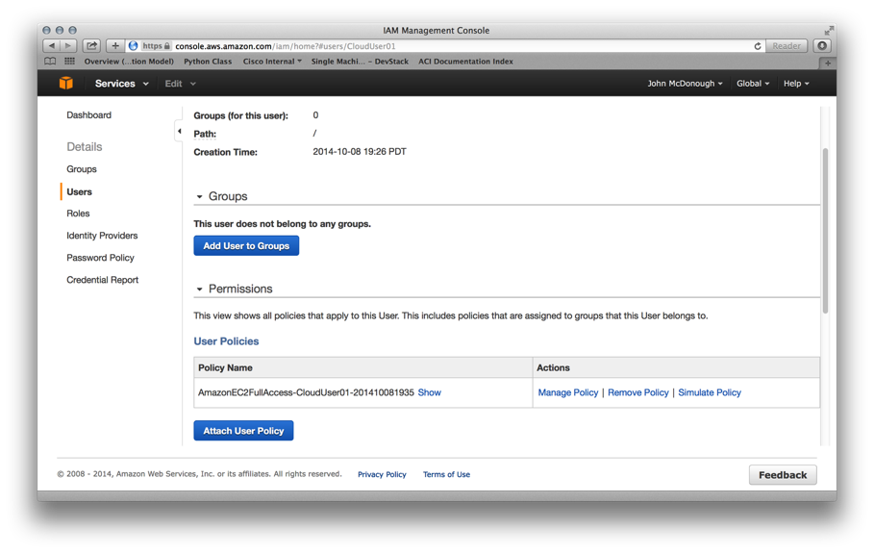
Click “Apply Policy” button, repeat the process for the “Amazon S3 Full Access” Policy
and for “AWS Marketplace Full Access”

Slide 23
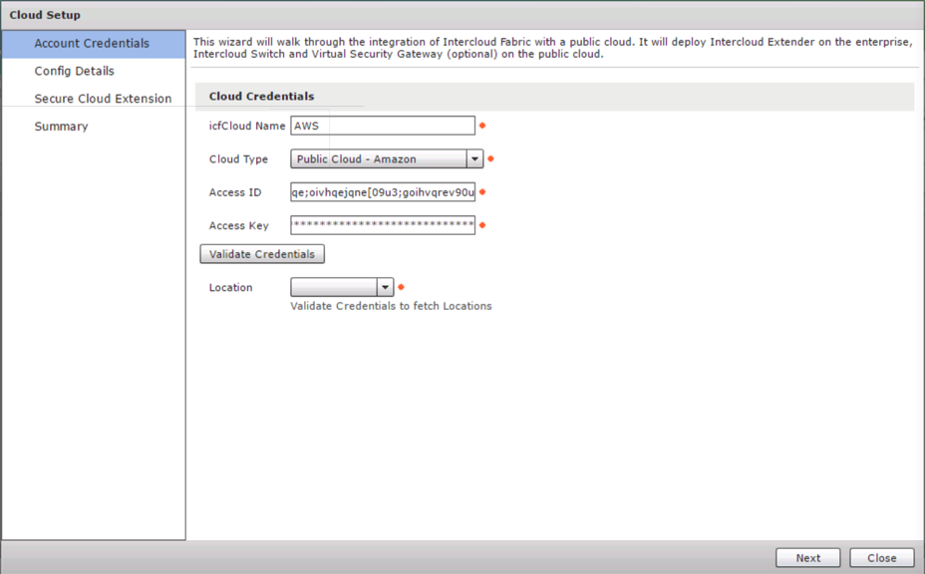
Use the created credentials in the IcfCloud setup for ICFB

Slide 24
Microsoft – Azure

Slide 25
Microsoft – Azure Account and Keys Steps
From ICFB “Export Azure Certificate”
Sign up for Azure account - http://azure.microsoft.com
Click “Sign up now”
Create an account
Verify your email address
Use the just created account to Sign in
Mobile Verification
Enter Mobile Verification Code
Provide Payment Information
Account is being setup, click refresh
Fully Enable Windows Azure
Notes:
Add a line that we are using VSG and CSR

Slide 26
Microsoft – Azure Account and Keys Steps continued
Scroll to and select “Settings” in the Azure Portal
Click “MANAGEMENT CERTIFICATES” Click “UPLOAD A MANAGEMENT CERTIFICATE”
Upload a management certificate, this is the one you exported from ICF
Return to Azure Portal Settings and copy the “SUBSCRIPTION ID”, this id the key for ICF
Use the created credentials in the IcfCloud setup for ICFB
Notes:
Add a line that we are using VSG and CSR

Slide 27
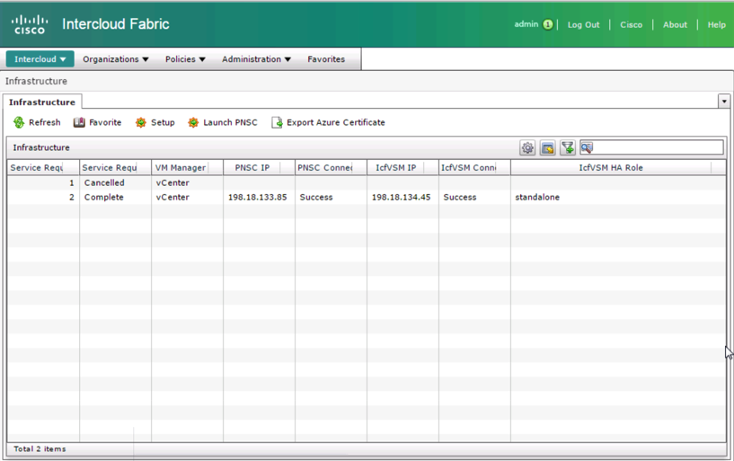
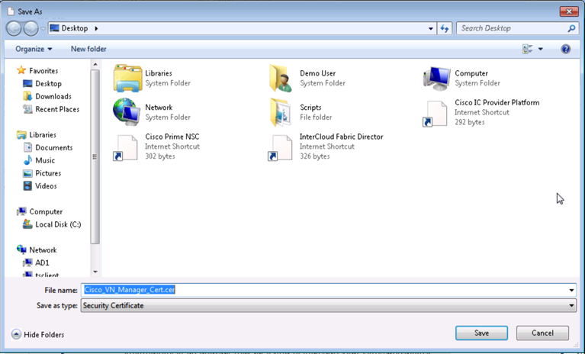
From ICFB “Export Azure Certificate”

Slide 28
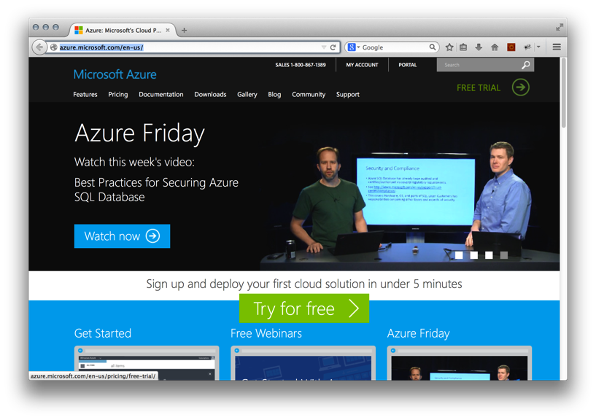
Sign up for Azure account - http://azure.microsoft.com

Slide 29
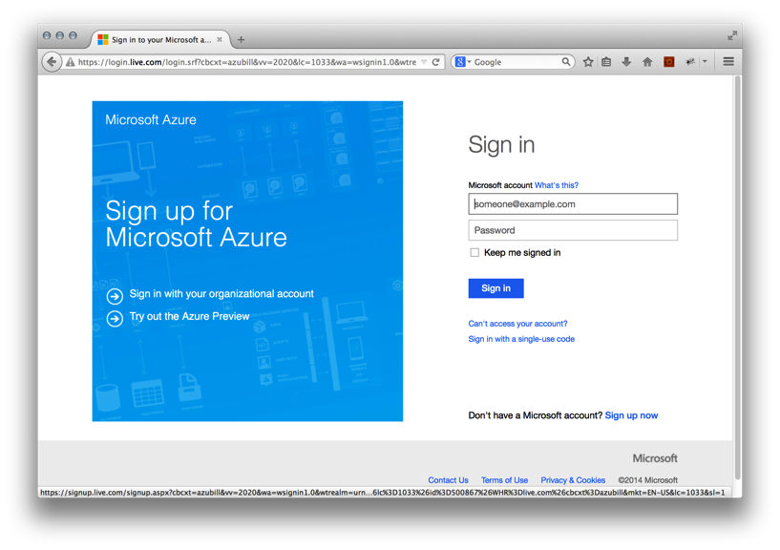
Click “Sign up now”

Slide 30
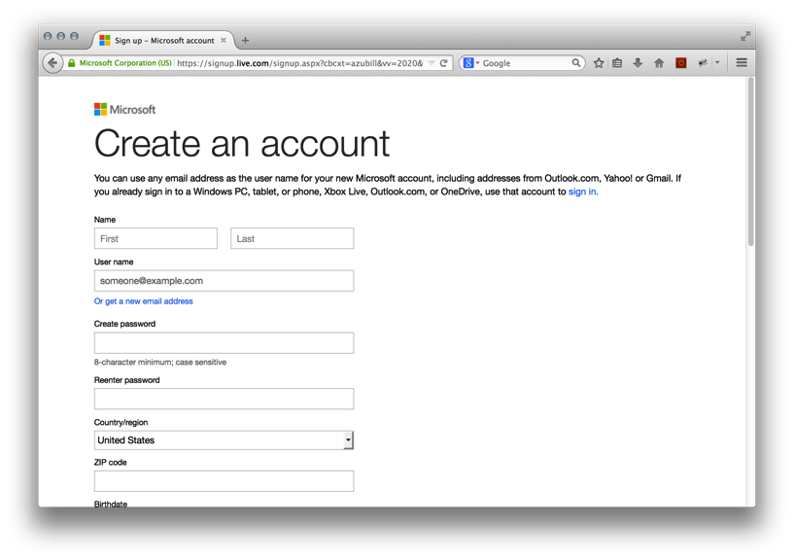
Create an account

Slide 31
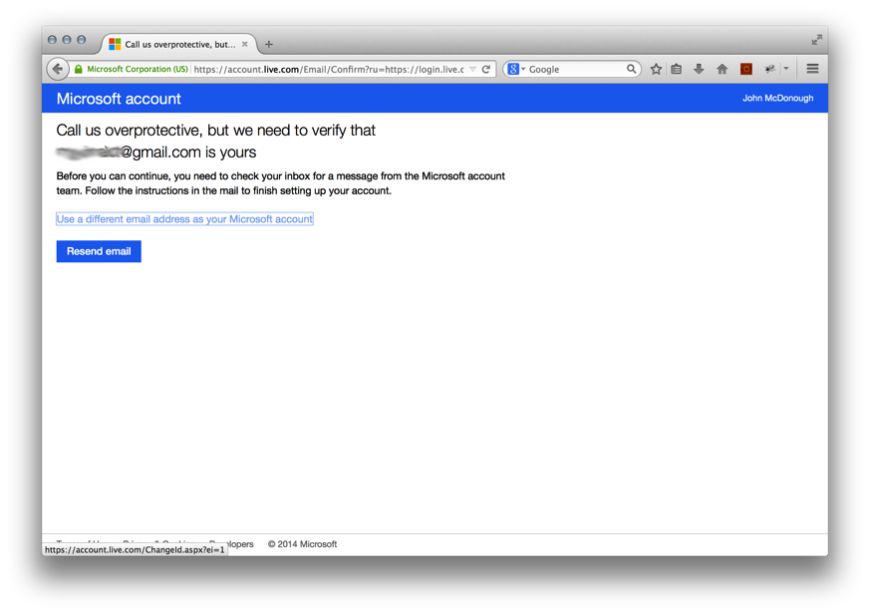
Verify your email address

Slide 32

Use the just created account to Sign in

Slide 33
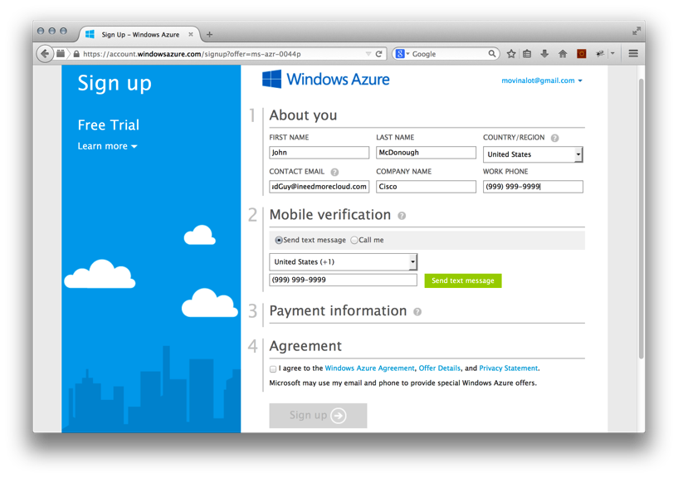
Mobile Verification

Slide 34

Enter Mobile Verification Code

Slide 35
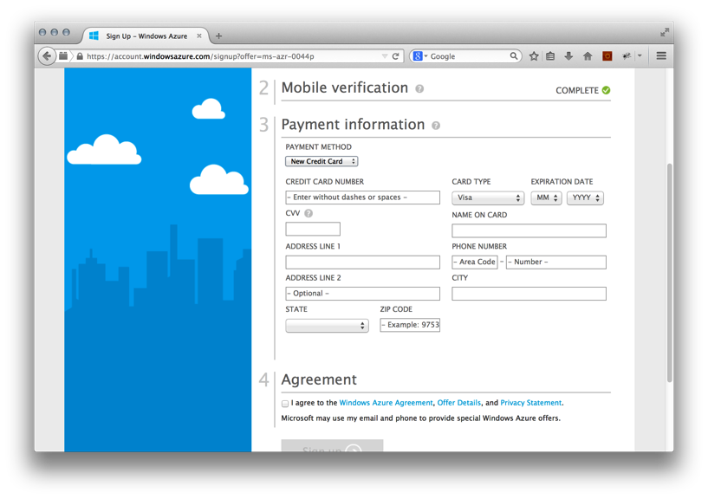
Provide Payment Information

Slide 36
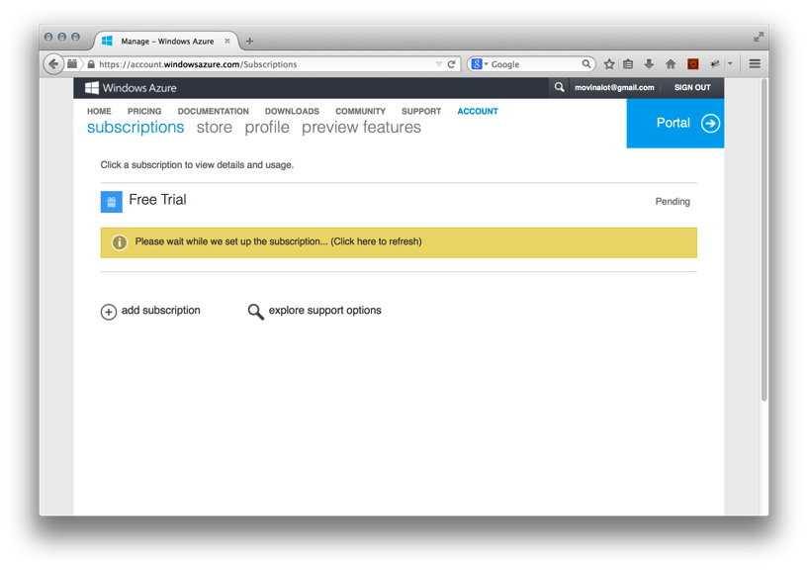
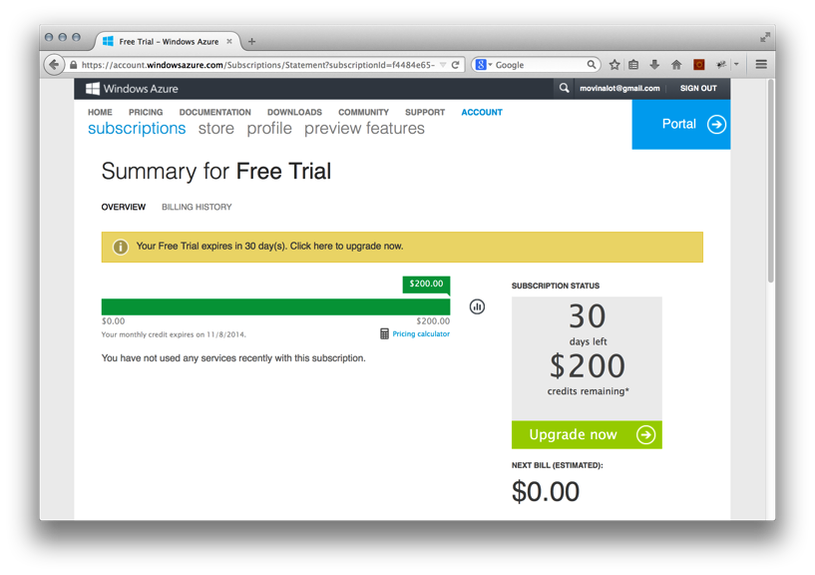
Account is being setup, click refresh

Slide 37
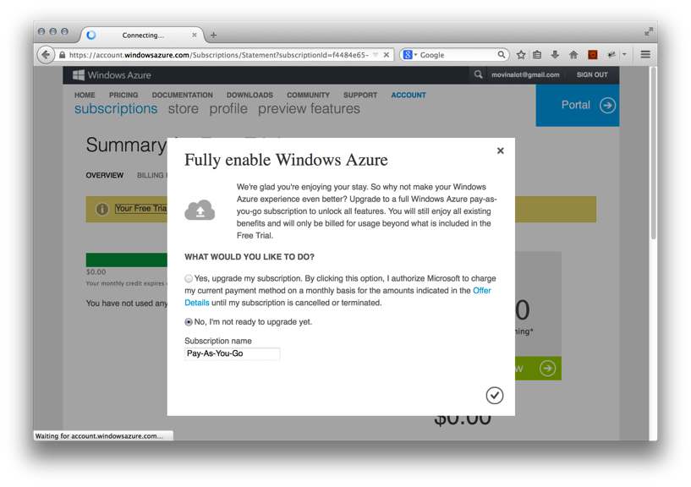
Fully Enable Windows Azure

Slide 38
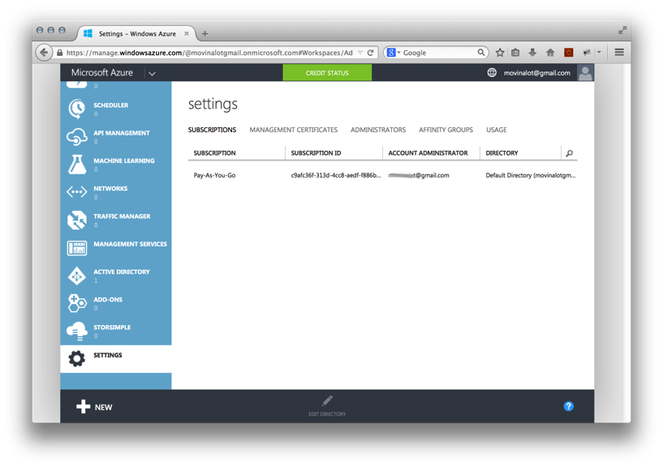
Scroll to and select “Settings” in the Azure Portal

Slide 39
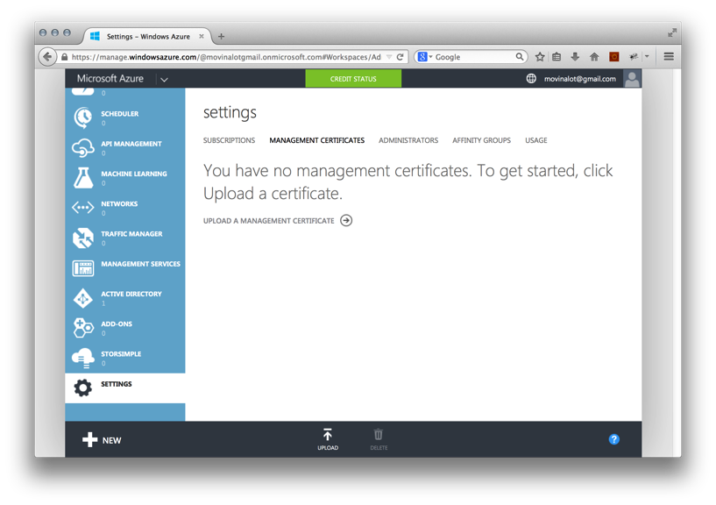
Click “MANAGEMENT CERTIFICATES” Click “UPLOAD A MANAGEMENT CERTIFICATE”

Slide 40
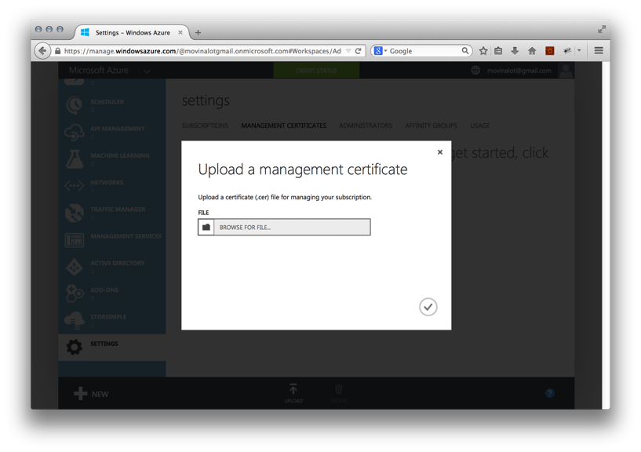
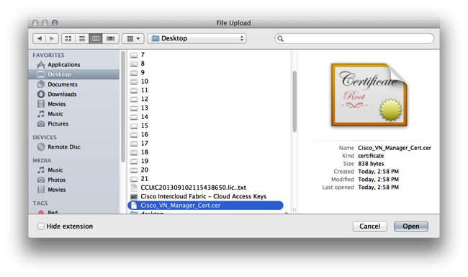
Upload a management certificate, this is the one you exported from ICF

Slide 41
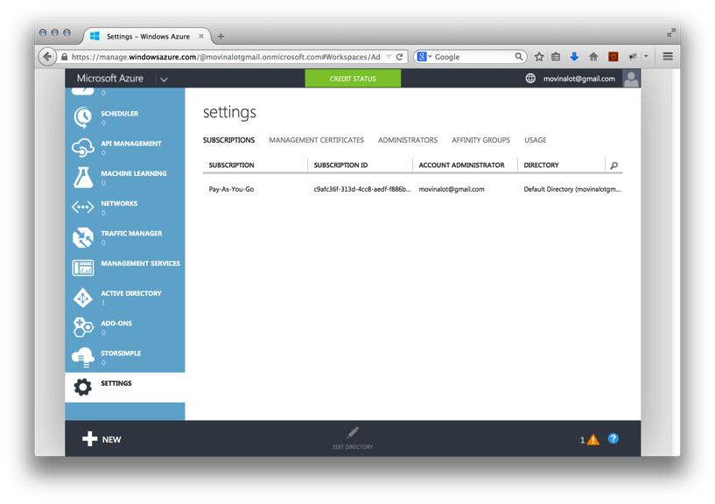
Return to Azure Portal Settings and copy the “SUBSCRIPTION ID”, this id the key for ICF

Slide 42
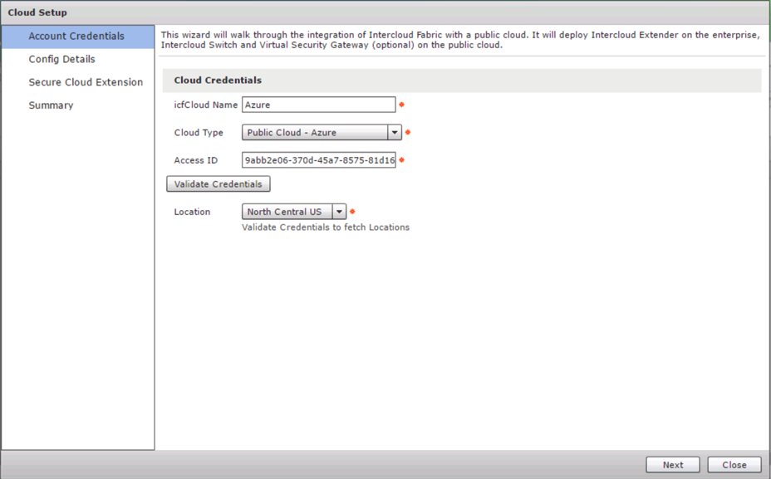
Use the created credentials in the IcfCloud setup for ICFB

